Slide 1
Behavioral Patterns part -III
Emre Kaplan, Ph.D.

Slide 2
Behavioral Patterns
Behavioral patterns are concerned with algorithms and the assignment of responsibilities between objects.
Behavioral patterns describe not just patterns of objects or classes but also the patterns of communication between them.
These patterns characterize complex control flow that's difficult to follow at run-time. They shift your focus away from flow of control to let you concentrate just on the way objects are interconnected.
Behavioral object patterns use object composition rather than inheritance.
Source: Erich Gamma, Richard Helm, Ralph Johnson, and John Vlissides. 1995. Design Patterns: Elements of Reusable Object-Oriented Software. Addison-Wesley Longman Publishing Co., Inc., Boston, MA, USA.

Slide 3
Behavioral Patterns
Behavioral Patterns
Template Method
Observer
Null Object
Iterator
State
Mediator
Strategy
Command
Visitor
Chain of Responsibility
Memento
Dependency Injection

Slide 4
Strategy Pattern
Define a family of algorithms, encapsulate each one, and make them interchangeable.
Strategy lets the algorithm vary independently from clients that use it.

Slide 5
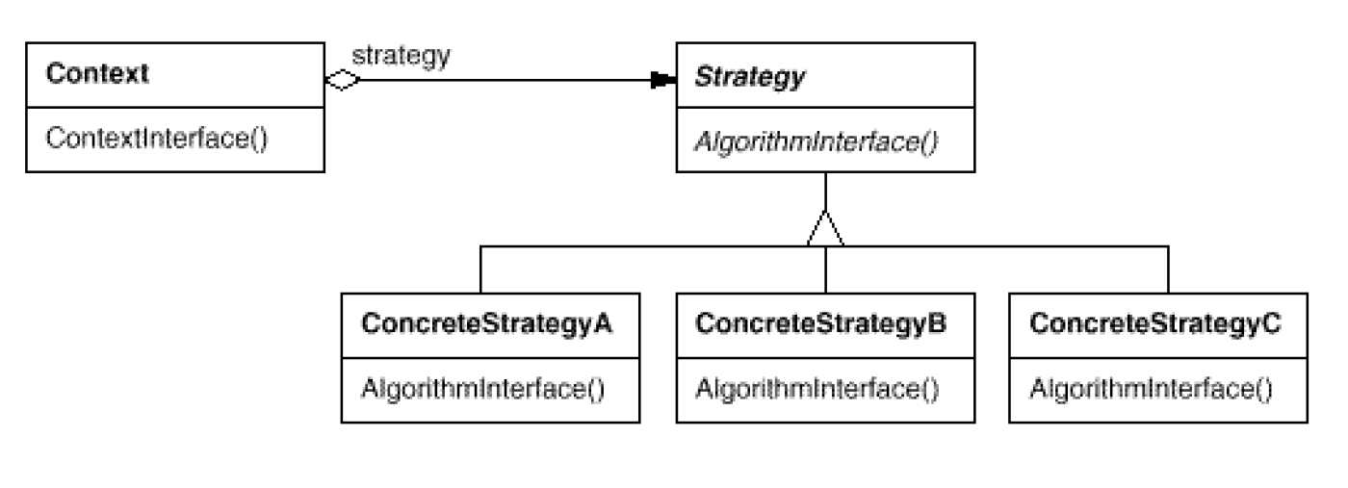
Strategy Pattern Structure

Slide 6
Strategy Pattern Structure
Strategy (Compositor)
declares an interface common to all supported algorithms. Context uses this interface to call the algorithm defined by a ConcreteStrategy
ConcreteStrategy
implements the algorithm using the Strategy interface.
Context (Composition)
is configured with a ConcreteStrategy object.
maintains a reference to a Strategy object.
may define an interface that lets Strategy access its data.

Slide 7
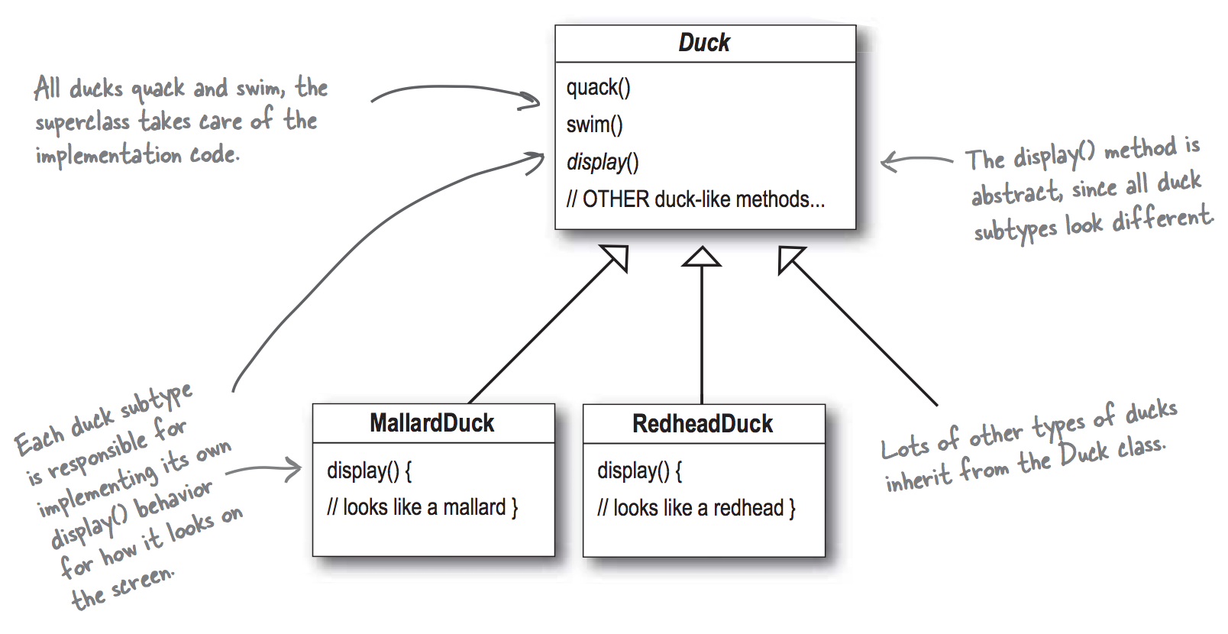
Version 1
Requirements
Simulate ducks
All ducks swim
All ducks quack
All ducks have an appearance, but Redhead, Mallard, YeşilbaşlıGövel etc. ducks look different from each other.

Slide 8
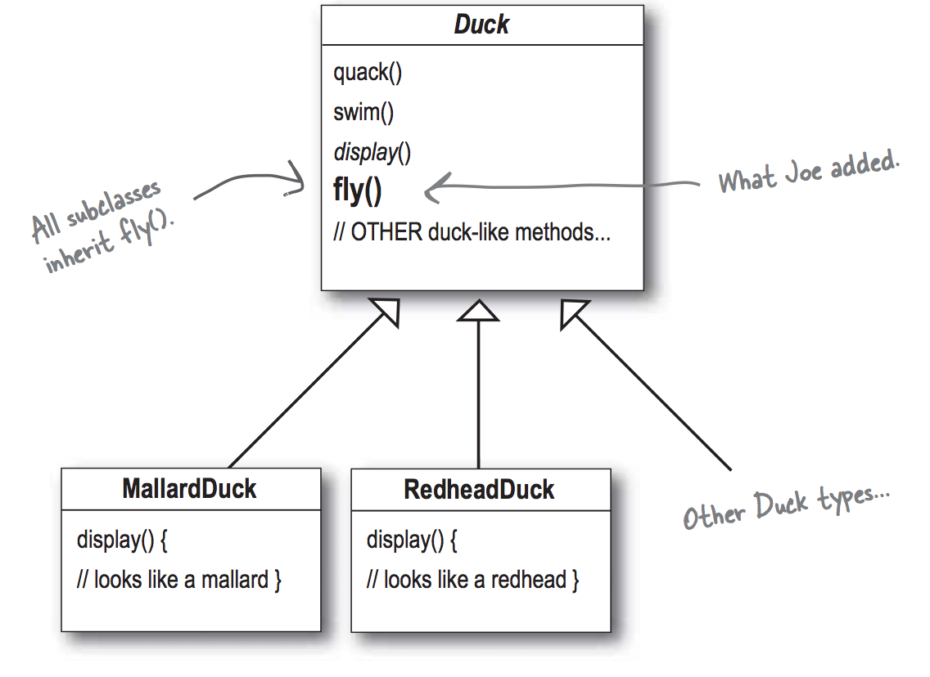
Version 2
New requirements
All ducks fly

Slide 9

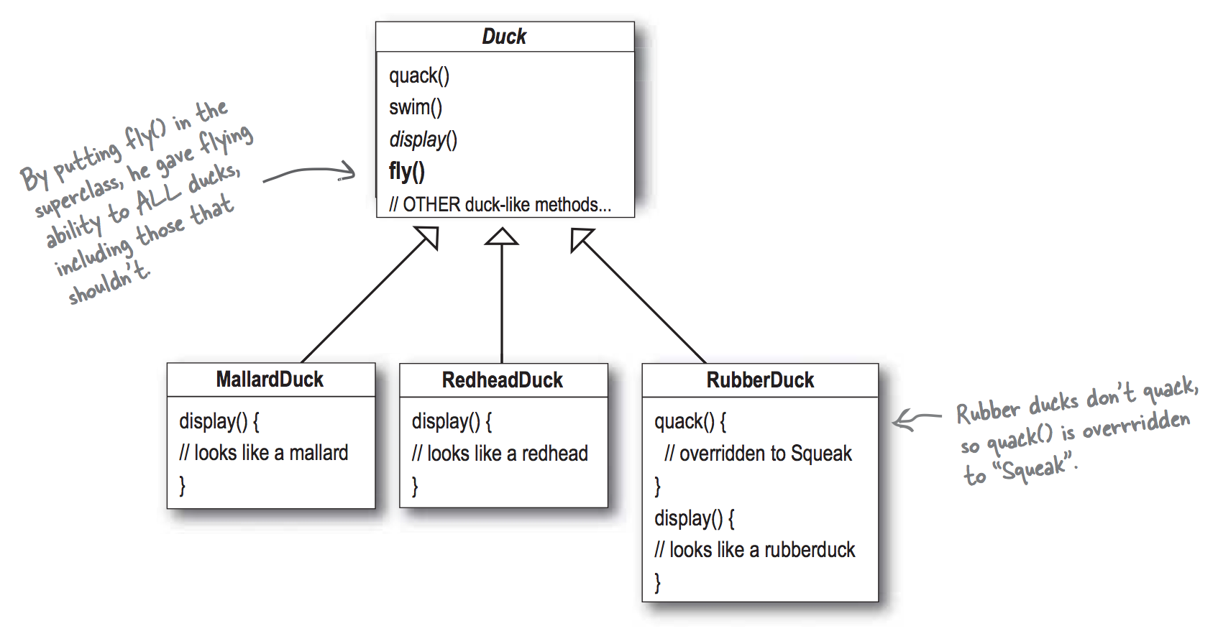
Version 3
New requirements
Simulate rubber ducks
Problem: rubber ducks can’t fly

Slide 10
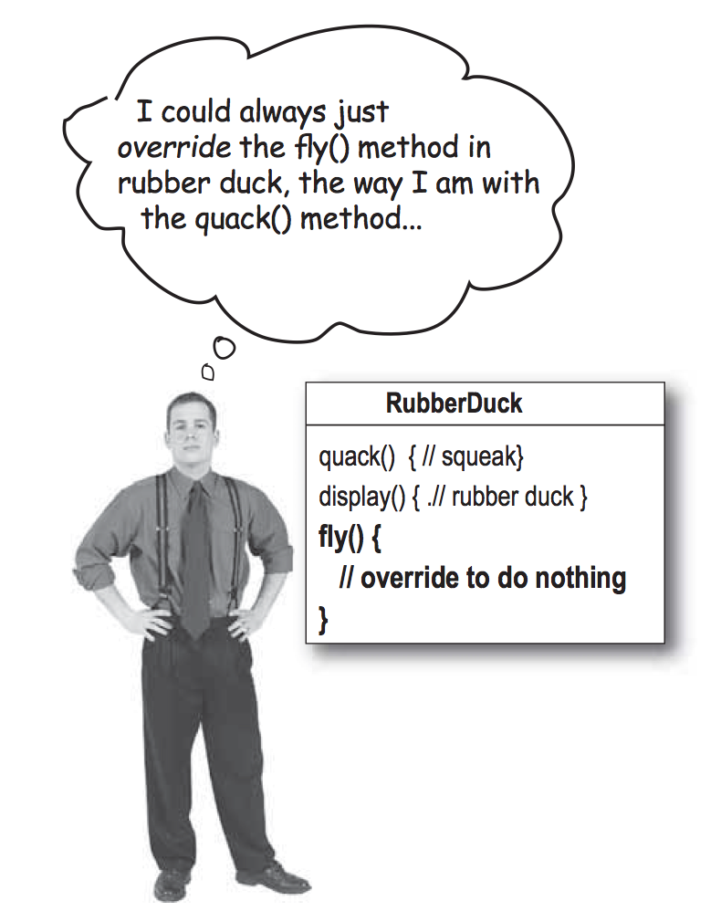
Version 4
Fix the flying rubber duck problem

Slide 11
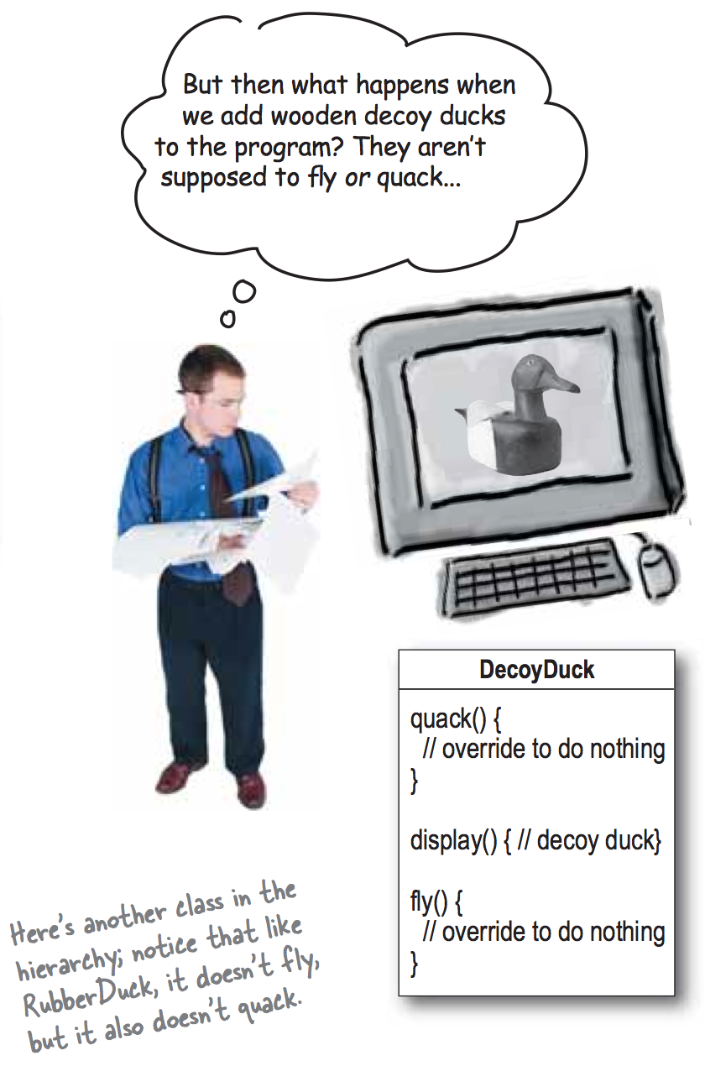
The “fix” is not maintainable

Slide 12
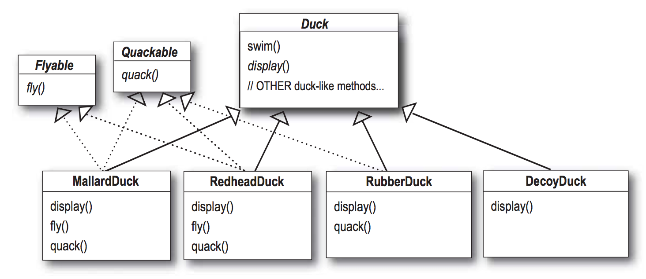
Version 5

Slide 13
Version 6
New requirements
Ducks can be equipped with a rocket to make them fly
Solution: Separate the flying behavior to make it configurable at runtime.

Slide 14
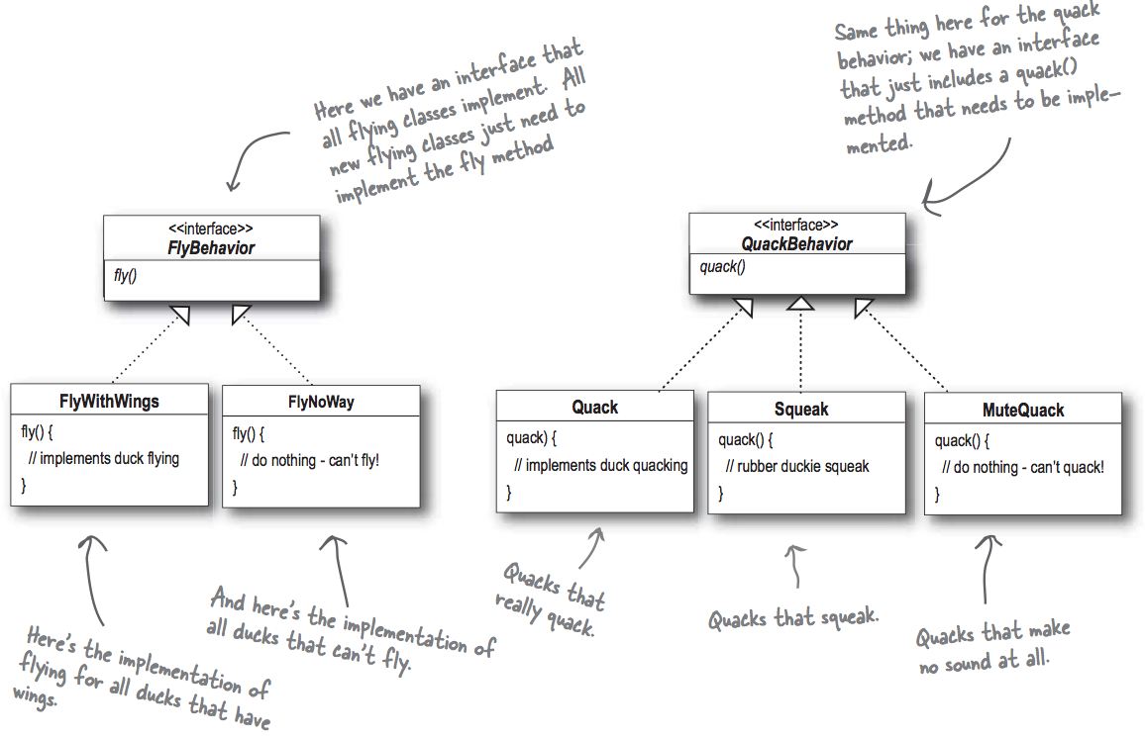
Version 6

Slide 15
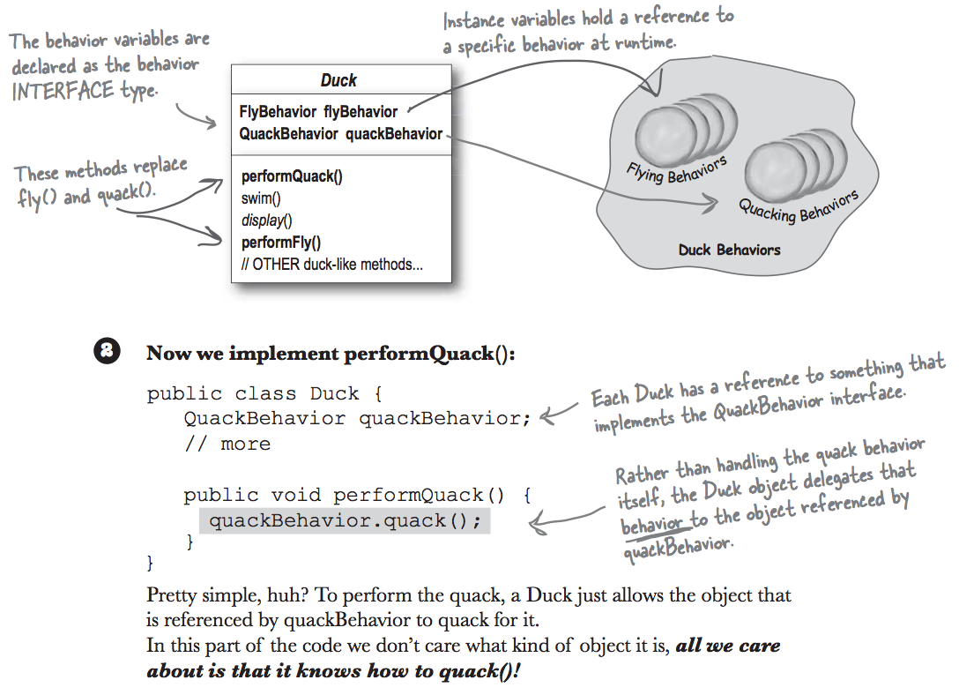
Version 6

Slide 16
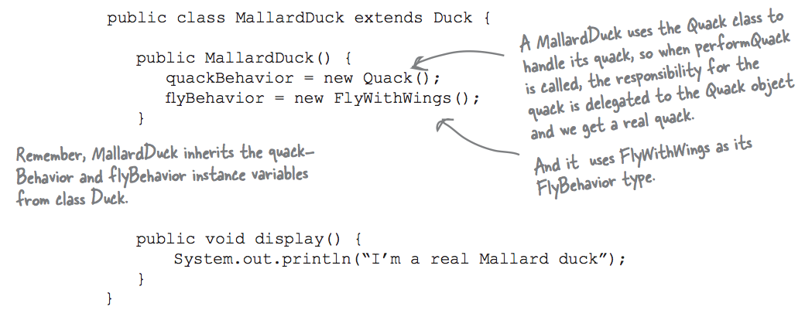
Version 6

Slide 17
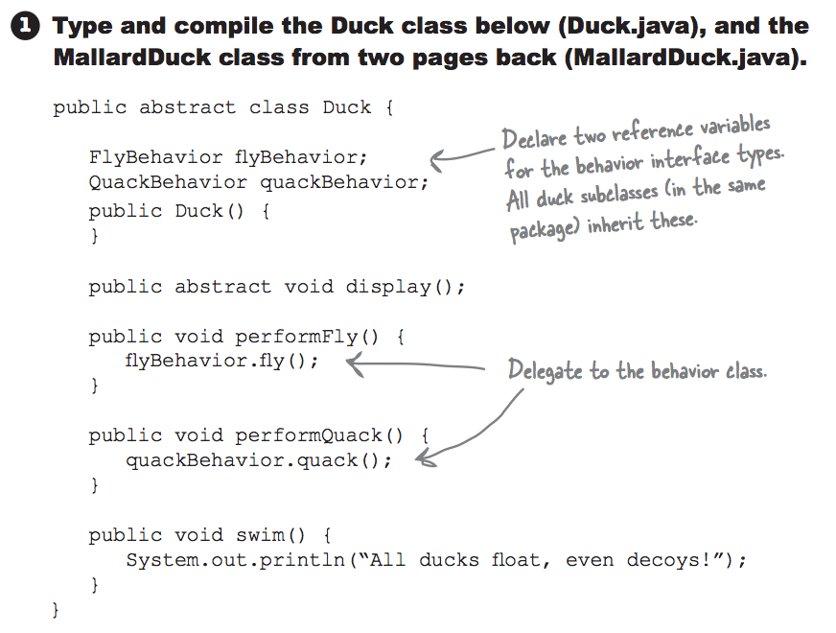
Testing Version 6

Slide 18
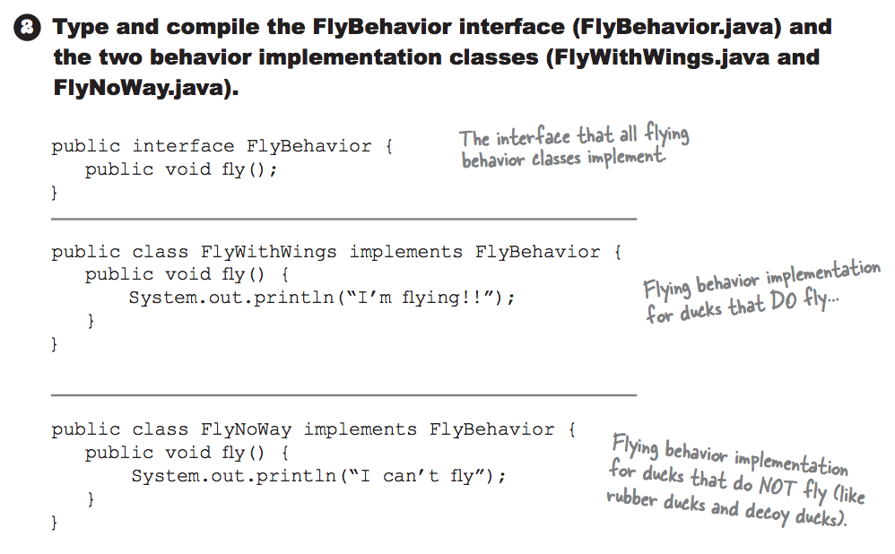
Testing Version 6

Slide 19
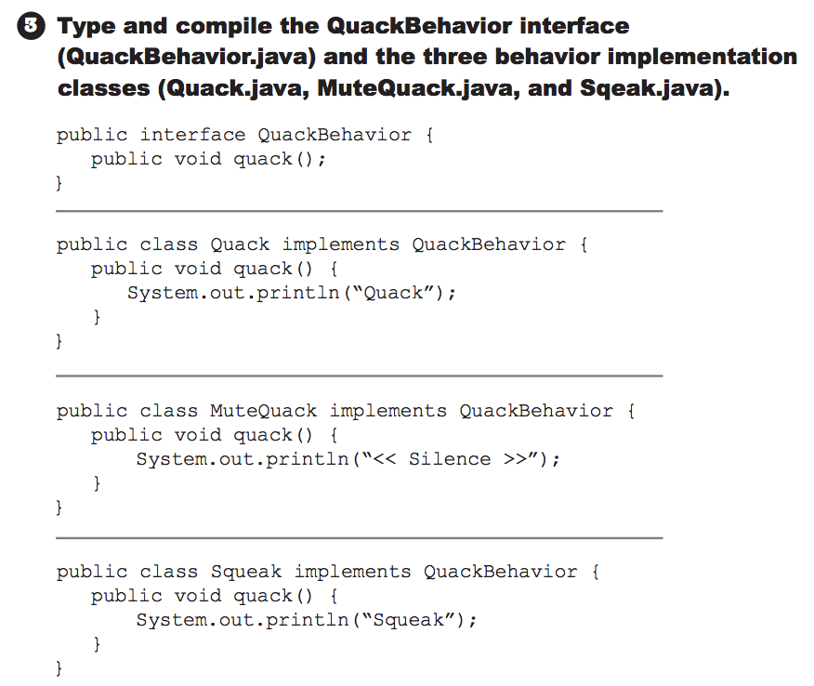
Testing Version 6

Slide 20
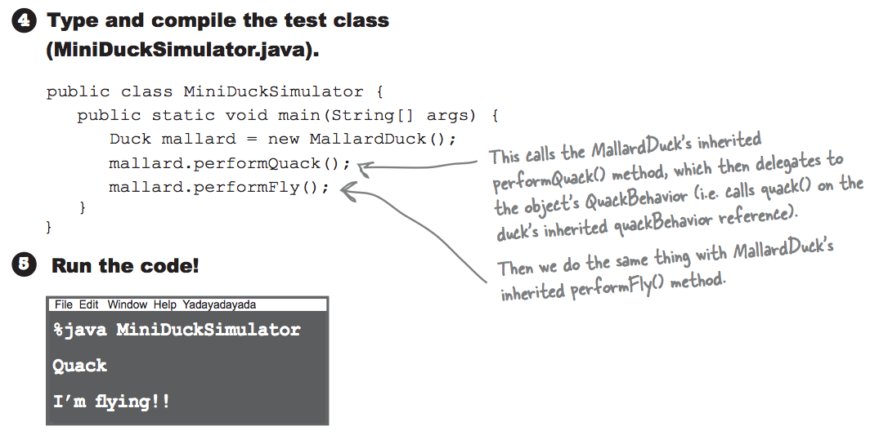
Testing Version 6

Slide 21
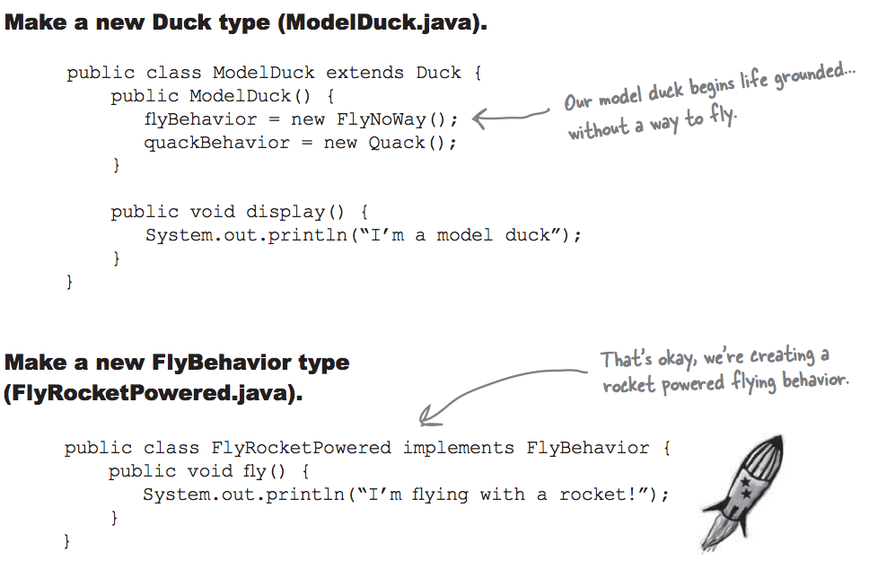
Testing Version 6

Slide 22
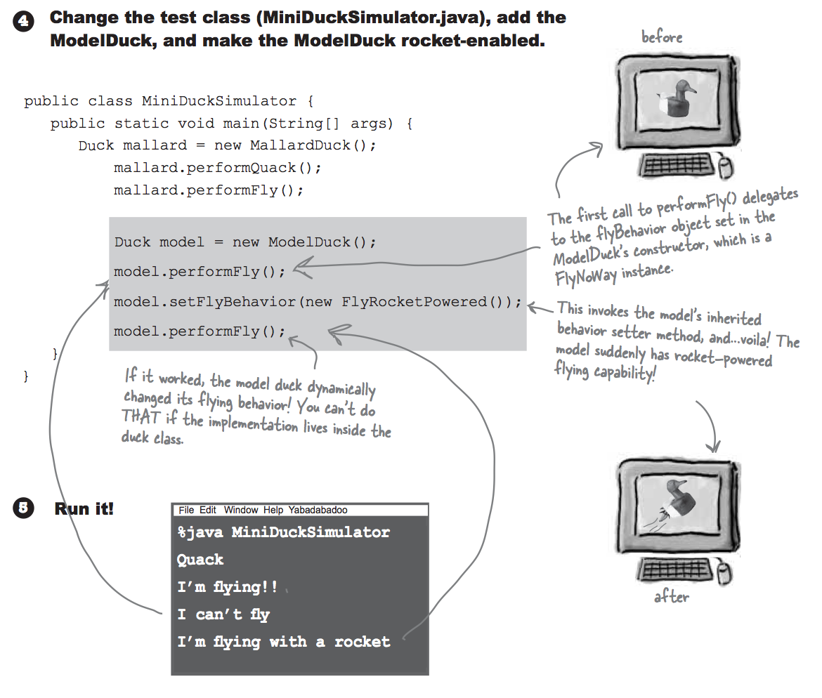
Testing Version 6

Slide 23
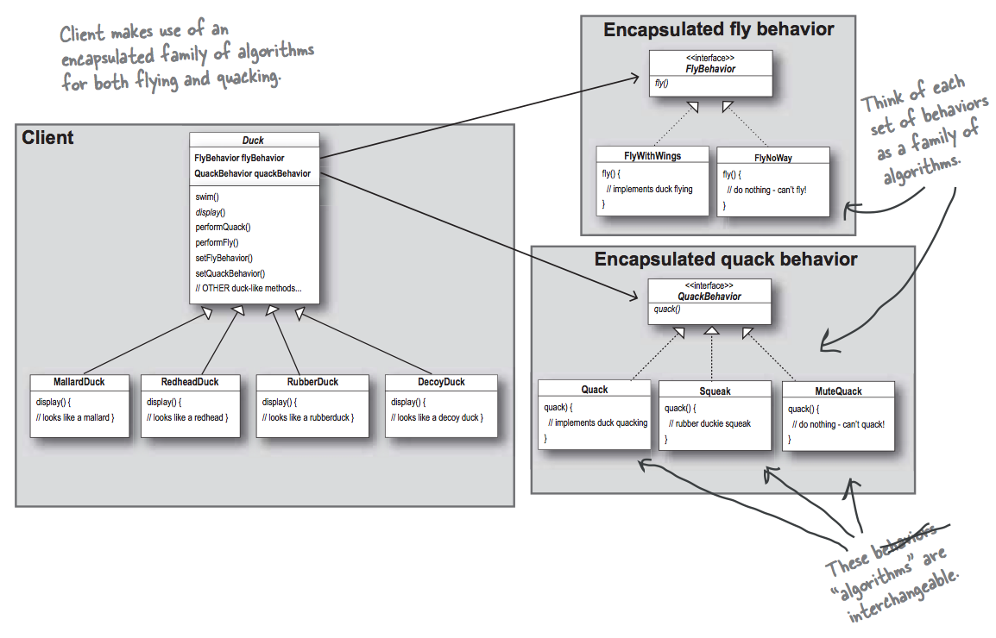
Version 6 – The big picture

Slide 24
Consequences
Families of related algorithms.
Hierarchies of Strategy classes define a family of algorithms or behaviors for contexts to reuse.
Encapsulating the algorithm in separate Strategy classes lets you vary the algorithm independently of its context, making it easier to switch, understand, and extend.
Strategies eliminate conditional statements. The Strategy pattern offers an alternative to conditional statements for selecting desired behavior.

Slide 25
Command
Intent
Encapsulate a request as an object, thereby letting you parameterize clients with different requests, queue or log requests, and support undoable operations.
Motivation
issue requests to objects without knowing anything about the operation being requested or the receiver of the request
add new types of requests

Slide 26
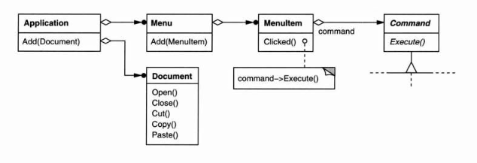
Command

Slide 27
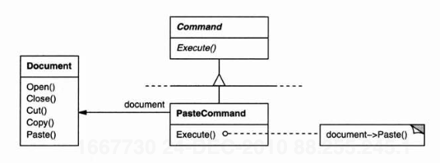
Command

Slide 28
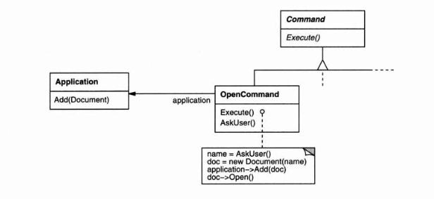
Command

Slide 29
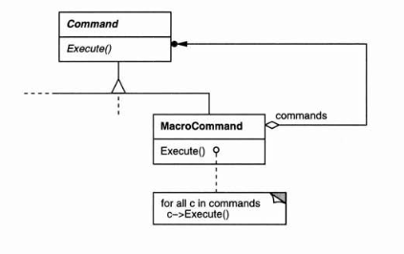
Sequence of Commands

Slide 30
Applicability
With Command, you can
specify, queue, and execute requests at different times. A Command object can have a lifetime independent of the original request.
transfer a command object for the request to a different process and fulfill the request there.
support undo. The Command's Execute operation can store state for reversing its effects in the command itself.
The Command interface must have an added Unexecute operation.

Slide 31
Applicability
With Command, you can
support logging changes so that they can be reapplied in case of a system crash.
extend the system with new transactions.
execute a group of Commands as a transaction

Slide 32
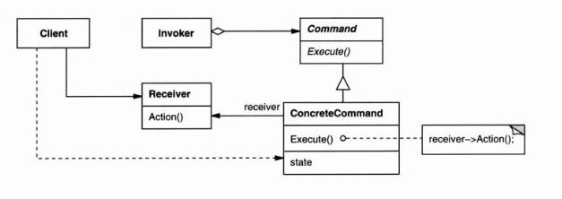
Structure

Slide 33
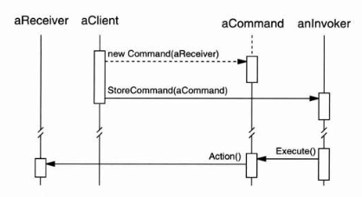
Collaborations
Command decouples the invoker from the receiver

Slide 34
Consequences
Commands are first-class objects. They can be manipulated and extended like any other object.
You can assemble commands into a composite command. An example is the MacroCommand class described earlier.
It's easy to add new Commands, because you don't have to change existing classes.

Slide 35
Visitor
Intent
Represent an operation to be performed on the elements of an object structure.
Visitor lets you define a new operation without changing the classes of the elements on which it operates.
Motivation
Compiler operations on abstract syntax trees

Slide 36
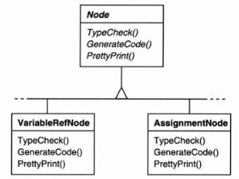
Visitor
Nodes are usually stable
Operations are scattered over nodes
Hard to maintain and add new operations

Slide 37
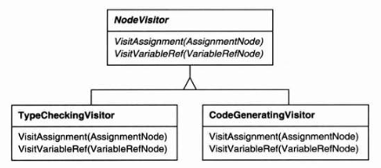
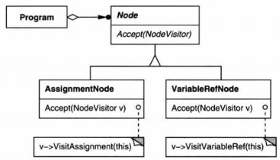
Visitor

Slide 38
Visitor
You define two class hierarchies:
one for the elements being operated on (the Node hierarchy)
one for the visitors that define operations on the elements (the NodeVisitor hierarchy).
Create a new operation by adding a new subclass to the visitor class hierarchy.
As long as we don't have to add new Node subclasses, we can add new functionality simply by defining new NodeVisitor subclasses.

Slide 39
Applicability
Use the Visitor pattern when
an object structure contains many classes of objects with differing interfaces, and you want to perform operations on these objects that depend on their concrete classes.
many distinct and unrelated operations need to be performed on objects in an object structure, and you want to avoid "polluting" their classes with these operations.
the classes defining the object structure rarely change, but you often want to define new operations over the structure.
If the object structure classes change often, then it's probably better to define the operations in those classes.

Slide 40
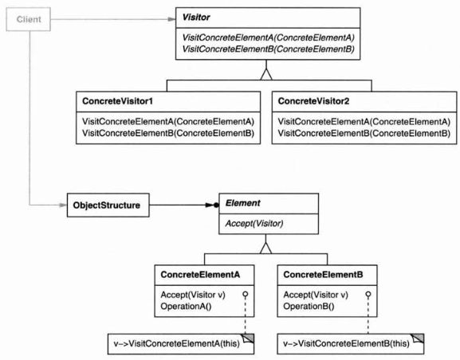
Structure

Slide 41
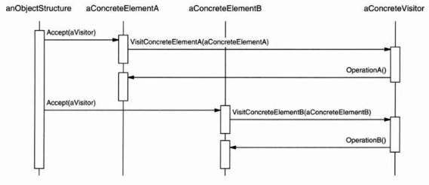
Collaborations

Slide 42
Consequences
Visitor makes adding new operations easy.
A visitor gathers related operations and separates unrelated ones.
Adding new ConcreteElement classes is hard.
Accumulating state.
Visitors can accumulate state as they visit each element in the object structure.
Without a visitor, this would be uglier.
Breaking encapsulation.
Often, you need to provide public operations that access a ConcreteElement's internal state

Slide 43
Visitor vs. Iterator
Visiting across class hierarchies.
An iterator can visit the objects in a structure as it traverses them by calling their operations.
But an iterator can't work across object structures with different types of elements.
template<class Item>
class Iterator {
// ...
Item CurrentItem() const;
};
class Visitor {
public:
// ...
void VisitMyType(MyType*);
void VisitYourType(YourType*);
};

Slide 44
Implementation
Who is responsible for traversing the object structure?
the object structure
the visitor
requires duplicating the traversal code in each ConcreteVisitor for each aggregate ConcreteElement.
a separate iterator object

